Slide 1

Quantifying the effect of CME removal on in-situ solar wind data assimilation
Harriet Turner, Mathew Owens, Matthew Lang, Siegfried Gonzi and Mike Marsh
1st March 2022

Slide 2

Outline
Background
Solar wind
Data assimilation
Recent work
Using BRaVDA for solar wind forecasts
Removing CMEs
Future work
Conclusions
H. Turner
h.turner3@pgr.reading.ac.uk
Quo Vadis

Slide 3
Background

Slide 4
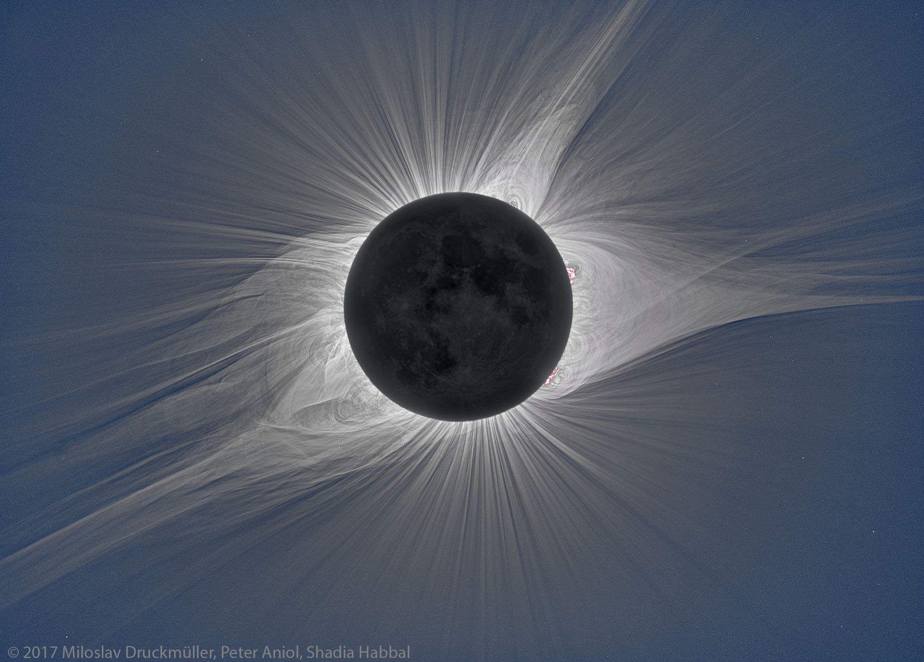
The solar wind
Continual emission of plasma from the Sun’s surface
Accelerates out into the solar system
Comprised mostly of protons and electrons
Solar activity varies over ~11 year cycle
Minimum and maximum phases
H. Turner
h.turner3@pgr.reading.ac.uk
Quo Vadis
Notes:
The solar wind is a continual outflow of plasma from the Suns surface that expands out to fill the solar system. It is predominantly comprised of protons and electrons as well as a smaller proportion of heavier ions. The Sun goes through an approximately 11-year activity cycle, with periods of minimum and maximum activity. During solar maximum, the solar wind is more dynamic and it evolves more quickly.

Slide 5
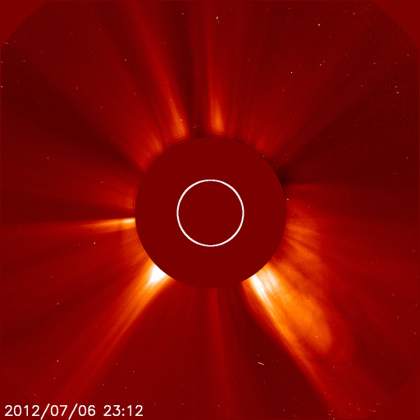
Coronal mass ejections (CMEs)
Coronal mass ejections (CMEs) – eruption of material and radiation
Propagate through the solar wind
Need to know solar wind conditions to help mitigate CME impact
Main driver of most severe space weather events
Source: NASA/ SOHO
H. Turner
h.turner3@pgr.reading.ac.uk
Quo Vadis
Notes:
Coronal mass ejections (CMEs) are huge, transient eruptions of coronal material and radiation, as you can see in this animation, where the white line is the outline of the Sun. They can cause impacts on Earth and as the solar wind is the medium through which they propagate, its conditions can effect the severity of these impacts. Therefore, we need to know and forecast the solar wind conditions to help mitigate the impacts of CMEs.

Slide 6
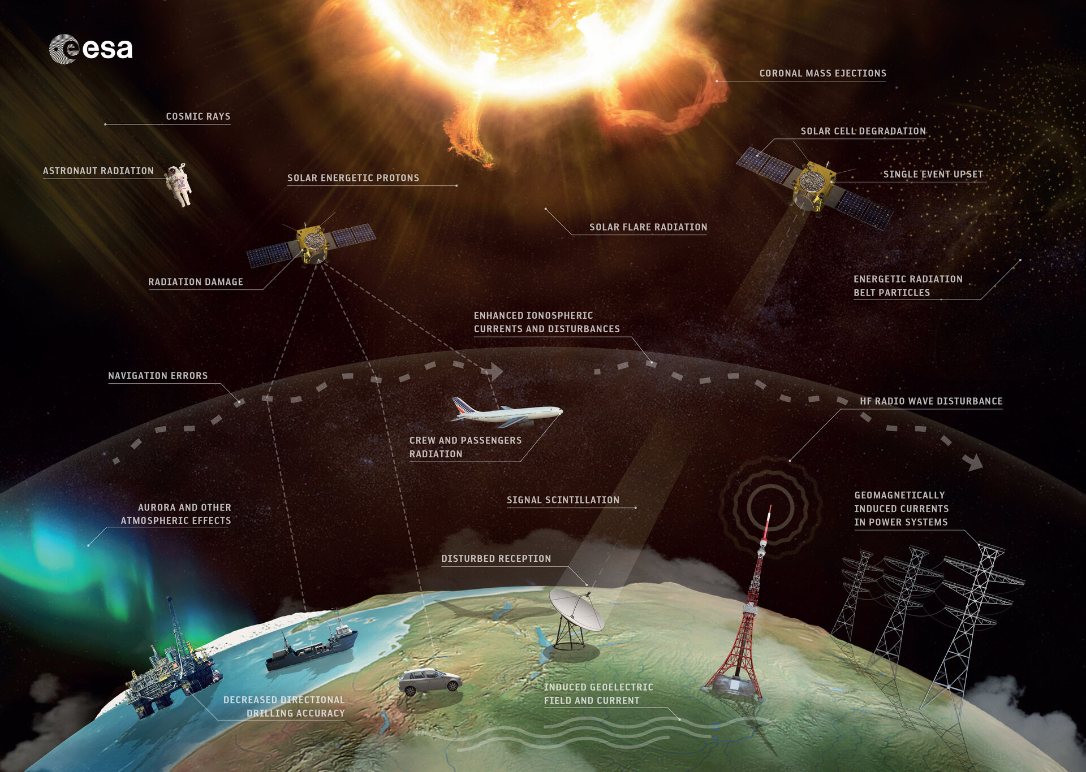
Space weather impacts
Source: ESA
H. Turner
h.turner3@pgr.reading.ac.uk
Quo Vadis
Notes:
The term space weather refers to the changing plasma conditions in near-Earth space. CMEs are the main driver of hazardous space weather and can have a number of impacts on Earth, as shown here. For example, currents can be induced in the power systems which can lead to transformers exploding and causing blackouts, which happened in Quebec in Canada in 1989. Radiation can also harm the health of astronauts in space or people on high altitude flights. The threat from space weather is so severe that it is on the national risk register, with the same impact as a volcanic eruption or flooding and the same likelihood as a flu pandemic.

Slide 7
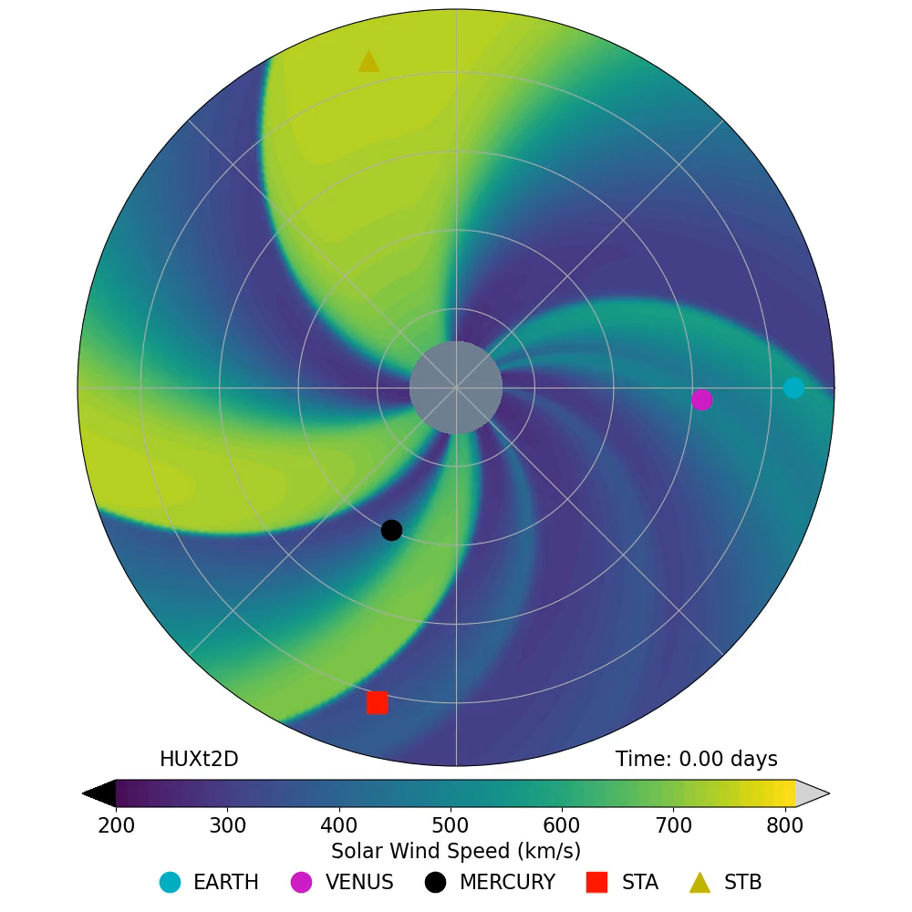
Solar wind structure
Sun rotates in 27 days as viewed from Earth
Bi-modal property – fast and slow wind
Fast wind greater than 600 km s⁻¹
Slow wind around 300 km s⁻¹
The Sun’s rotation pulls its magnetic field into an Archimedean spiral
Solar wind flow is radial
Animation source: HUXt Solar wind model, Owens et al. (2020)
H. Turner
h.turner3@pgr.reading.ac.uk
Quo Vadis
Notes:
The Sun rotates in 27 days with respect to Earth and the solar wind is bi-model in property. There are streams of fast solar wind greater than 600 km s⁻¹ and slow solar wind around 300 km s⁻¹. Due to the rotation of the Sun, its magnetic field gets pulled into an Archimedean spiral shape, as seen in this animation. Solar wind flow is still radial however. You can see here the streams of fast solar wind in yellow and slow solar wind in blue. We can see Earth, Venus and Mercury as well as the STEREO-A and B spacecraft, which I will discuss later.

Slide 8
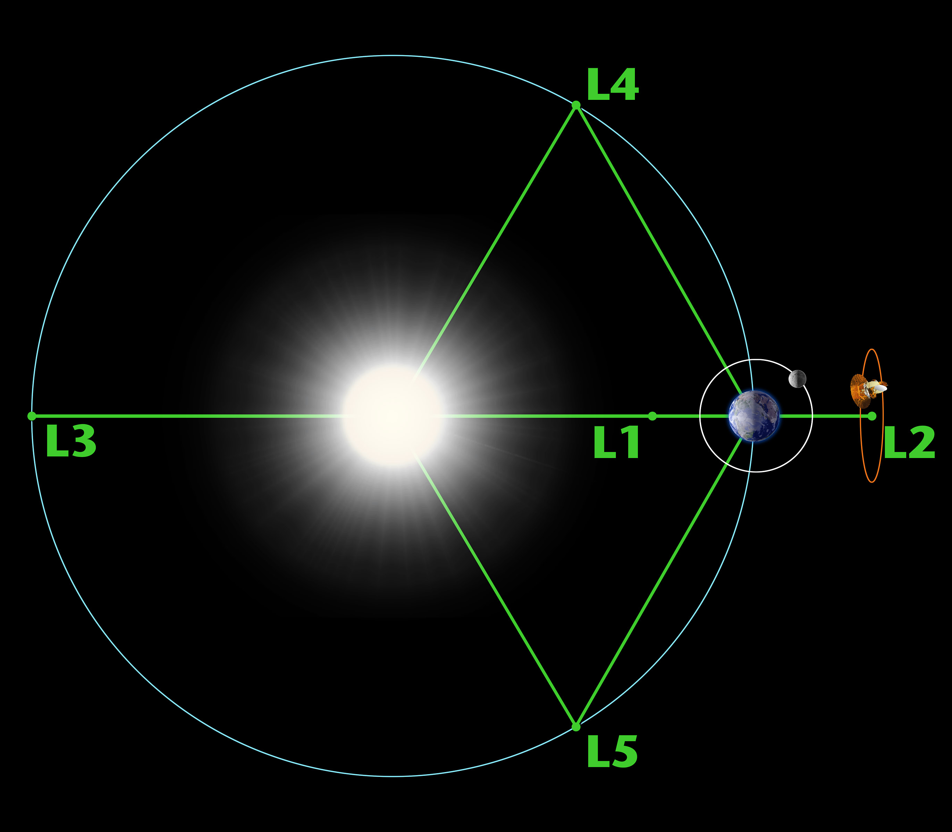
Current forecasting
Coupled coronal and solar wind models
Coronal models based on empirical relations – Suns surface to 30 R_{s}
Magnetohydrodynamic (MHD) model – 30 R_{s} into the solar system
Limited warning from L1 spacecraft
Current forecasting has no observational constraints after 30 R_{s}
Not to scale
H. Turner
h.turner3@pgr.reading.ac.uk
Quo Vadis
Notes:
Current forecasting methods use coupled coronal and solar wind models. The coronal models use empirical relations and model the space from the Suns surface out to 30 solar radii. The solar wind models are known as magnetohydrodynamic (or MHD) models and these are used to propagate the solar wind from 30 solar radii out to Earth’s orbital radius, which is at 215 solar radii, and into the solar system. There are 5 Lagrange points, which are gravitational nulls whereby the gravity of the Sun, Earth and moon are balanced. These are good places for spacecraft, as they require limited fuel to remain in that location. L1 is on the Sun-Earth line, however these provide only limited warning of around 1-hour of any Earth-directed event. Current forecasting techniques have no observational constraints after 30 solar radii, so this is where data assimilation comes in.

Slide 9
Data assimilation
Observations
Combining model output and observations to form an optimum estimation of reality
Led to large improvements in terrestrial weather forecasting
Under used in space weather forecasting
Model output
Data assimilation
Optimal state of the system
Forecast
H. Turner
h.turner3@pgr.reading.ac.uk
Quo Vadis
Notes:
Data assimilation combines model output and observations to form an optimum estimation of reality. It has led to large improvements in terrestrial weather forecasting, but has been under used in space weather forecasting. However, it is starting to gain more traction.

Slide 10
Recent work

Slide 11
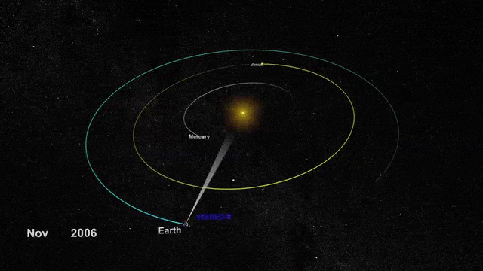
BRaVDA scheme
Burger Radius Variational Data Assimilation scheme (Lang and Owens, 2019)
Uses solar wind propagation model and observations from STEREO spacecraft and OMNI dataset
3 sources of observations
Spacecraft observations can be assimilated together or individually
Reconstructs solar wind in 27-day windows from 30 to 215 R_{s}
H. Turner
h.turner3@pgr.reading.ac.uk
Quo Vadis
Notes:
I have been running numerous experiments using the BRaVDA scheme, developed by Matt Lang. BRaVDA stands for Burger radius variational data assimilation and it uses a solar wind propagation model and observations from the STEREO spacecraft and the OMNI data set. The STEREO spacecraft are on similar orbits to Earth, but separated in longitude. The OMNI dataset is taken from a succession of spacecraft at L1 and the data is propagated to Earth. This means that there are 3 sources of observations and these can be assimilated together or separately in BRaVDA. The solar wind is reconstructed in 27-day windows from 30 solar radii to Earth’s orbital radius, 215 solar radii.

Slide 12
Solar wind forecasts from BRaVDA
Using the 27-day reconstruction, this can be used to forecast the next 27 days
Forecasts for Earth, STEREO-A and STEREO-B
t₀₋₂₇
t₀
t₂₇
Assimilation window
Forecast window
DA output
Solar wind speed
Forecast
t
H. Turner
h.turner3@pgr.reading.ac.uk
Quo Vadis
Notes:
Using the 27-day reconstruction of the solar wind from BRaVDA, this can be used to forecast the next 27 days. We generate forecasts for Earth, STEREO-A and STEREO-B, as these are where we have observations to compare the forecasts to. Say t-zero is now, then we can assimilate observations from the previous 27 days to reconstruct the solar wind. This output can then be projected forward, making the implicit assumption that the next 27 days will be the same as the previous 27 days. As the solar wind is time-varying, this assumption does not always hold. To build a forecast time series, BRaVDA is initialised on a daily cadence, so each day in the analysis period will have a forecast for each lead time from 0 to 27 days.

Slide 13
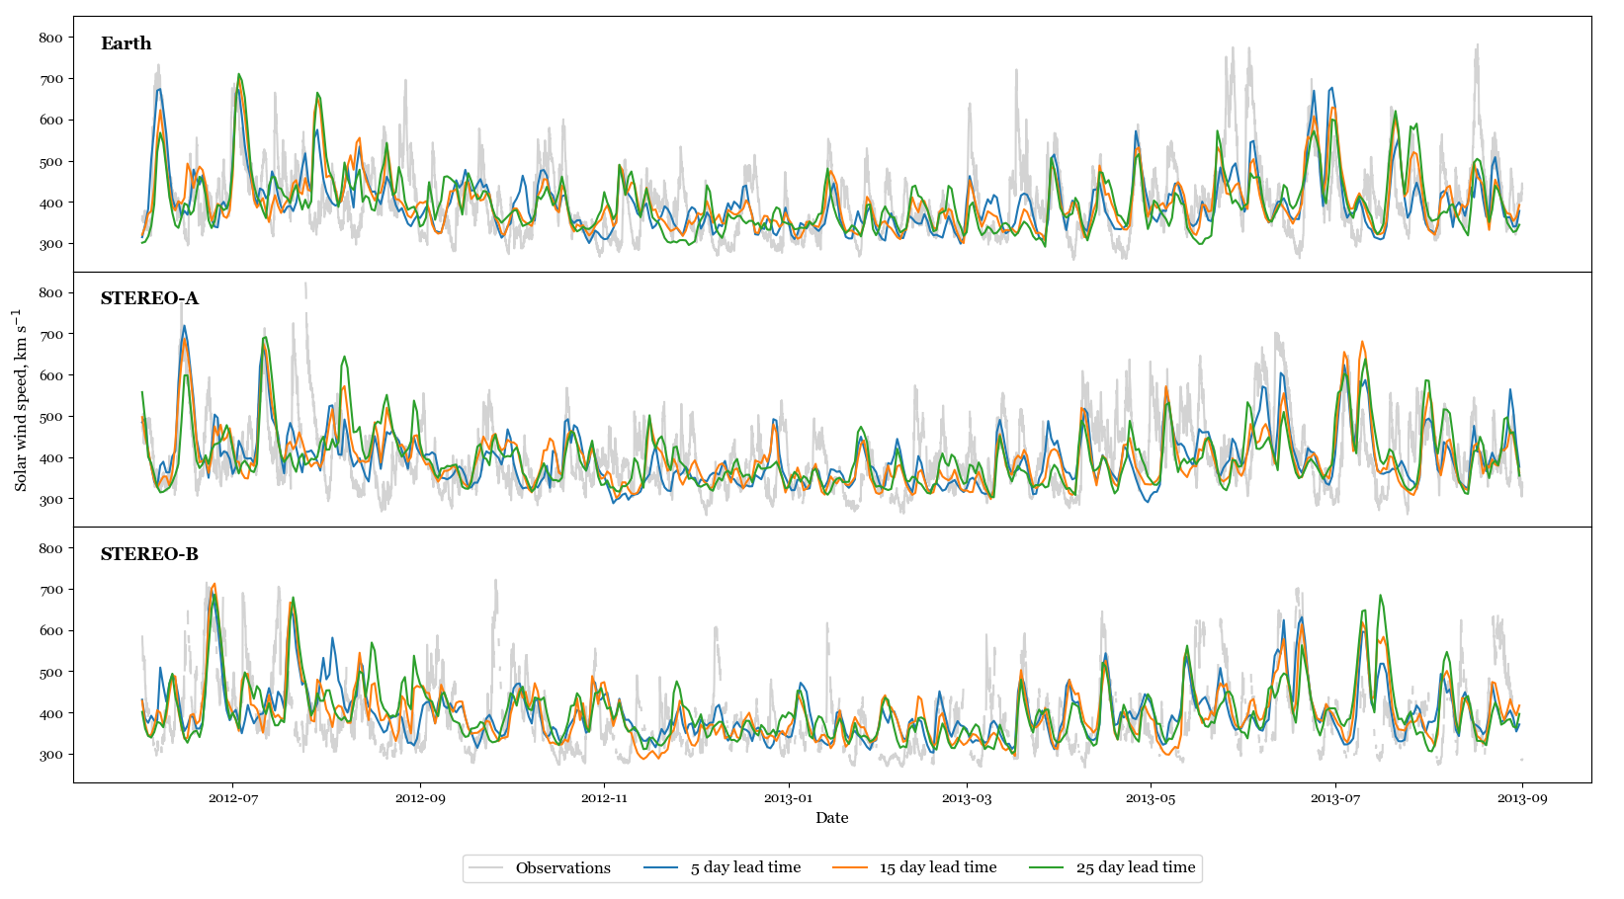
Forecast verification
H. Turner
h.turner3@pgr.reading.ac.uk
Quo Vadis
Notes:
Looking at these forecast time series, we can compare them with the observations from the respective spacecraft. Here, we have assimilated observations from all three spacecraft and the plot shows the observations in grey, the 5-day lead time forecast in blue, 15 day in orange and 25 in green. The solar wind speed, in km s⁻¹, is on the y-axis and this covers the period from April 2012 to October 2013. We can see that the forecasts do perform well in places, however there are a number of periods of faster solar wind that have not been captured in the forecast.

Slide 14
CME removal
BRaVDA has no knowledge of CMEs, so observations are treated as the steady- state solar wind
CMEs could produce false streams in the solar wind reconstruction or false alarms in the forecast
Removed from the DA input time series and linearly interpolated over
H. Turner
h.turner3@pgr.reading.ac.uk
Quo Vadis
Notes:
I have been experimenting with removing CMEs from BRaVDA. It has no knowledge of CMEs, so if a fast CME is observed at one of the spacecraft, this is essentially treated as the steady-state solar wind and reconstructed as such. Therefore, CMEs could produce false streams in the solar wind reconstruction which could lead to false alarms in the forecast. To remove them, I have used the start and end date from a CME catalogue and removed the data, plus 24 hours either side. I then linearly interpolated over the gap. This is appropriate to do due to the highly correlated nature of the solar wind. CMEs were removed from the DA input time series, which is the observations that are put into the DA scheme. When looking at a total of 3 years worth of forecasts, removing CMEs led to an improvement in the forecasts, but it was necessary to look at a case study to illustrate the wider effect.

Slide 15
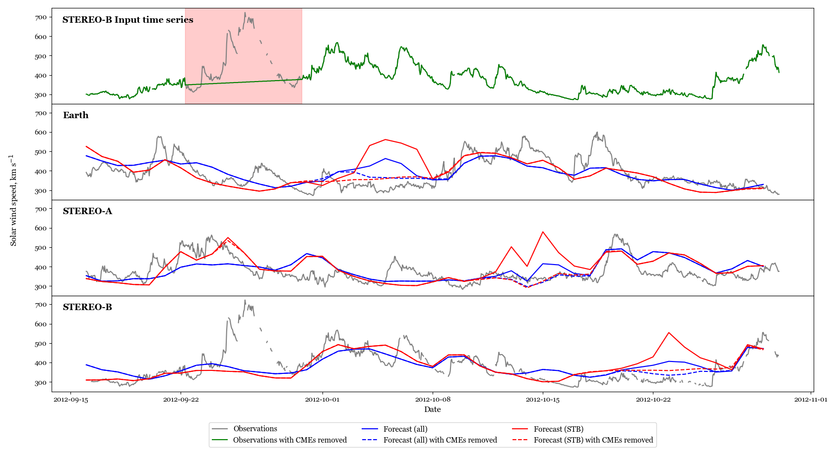
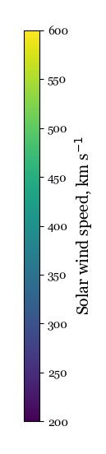
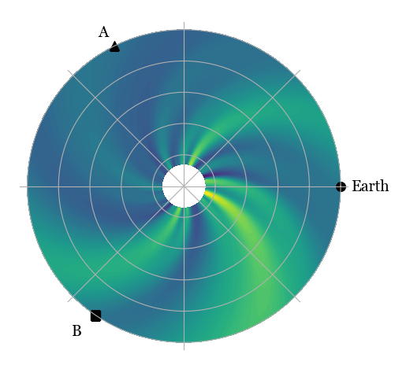
CME removal
H. Turner
h.turner3@pgr.reading.ac.uk
Quo Vadis
Notes:
In September 2012, a fast CME of over 700 km s⁻¹ was observed at STEREO-B. The top panel of this plot shows the input time series for the DA, with the observations in grey and the CME highlighted in the red shaded region. The green line shows the new time series with the CME interpolated over. For this case study, only this CME was removed from the time series, so all the other CMEs remain. This allows for better analysis of the impact it makes as there is no interference of the effects from other CMEs. The next three panels shows the 5-day lead time forecast at Earth, STEREO-A and STEREO-B. This shows two situations; the blue lines show when all spacecraft observations are assimilated and the red lines show when only STEREO-B observations are assimilated. The solid lines show the forecast with no changes made and the dashed line is when the single CME is removed. We can see that the impact of removing the CME occurs after a delay. This is due to the longitudinal separation between the CME observation at STEREO-B and the location of the forecast as it takes time for the Sun to rotate from one spacecraft to the next. At this time, STEREO-B is about 120 degrees away from Earth, and the Sun takes about 9 days to rotate through this angle, hence this delay in the Earth forecast. This similarly happens for STEREO-A and then the full 27 day rotation back to STEREO-B. Comparing the solid and the dashed lines, you can see that removing the CME reduces the forecast speed by approximately 250 km s⁻¹ for the red line and 100 km s⁻¹ for the blue, bringing the forecast closer to the observations. You can also see that the size of the false alarm in the forecast time series is reduced when all spacecraft observations are assimilated, so we can say that it is better to assimilate multiple spacecraft rather than a single spacecraft.

Slide 16
Future work
Looking at the impact of observational age
All experiments have been with science-level data
Testing the performance of BRaVDA with real-time data
Required for operational deployment
H. Turner
h.turner3@pgr.reading.ac.uk
Quo Vadis
Notes:
I am currently looking at the impact of observational age on the forecast error. When assimilating the previous 27 days worth of observations, the age of the observations available to the DA varies depending on the forecast lead time, so I am looking at quantifying this effect.
All the experiments so far have been run using pre-processed, science-level data. For the DA scheme to be run operationally, it will need to work with the real-time data from the spacecraft and so I will test BRaVDA’s performance using archived real-time data. This data will contain larger data gaps and erroneous results, so BRaVDA needs to be able to cope with this.
Possible Q: what impact would this have on error covariances? Don’t know yet – this is why we are doing it (expect error to increase)

Slide 17
Conclusions
Solar wind forecasting required to mitigate impacts on Earth
Data assimilation is in early development stages for space weather forecasting
Our implementation has improved solar wind forecasts
Looking at 3 years of forecasts, removing CMEs improves forecast accuracy
Better to assimilate multiple spacecraft observations rather than single spacecraft observations
Moving towards using real-time data
H. Turner
h.turner3@pgr.reading.ac.uk
Quo Vadis
Notes:
To conclude, solar wind forecasting is required to help mitigate the impacts of hazardous space weather on Earth. Data assimilation is in the early development stages for solar wind forecasting, however the implementation developed at Reading has improved solar wind forecasts. I have analysed a total of 3 years worth of forecasts and have found that removing CMEs from the input time series has led to improvement in the forecast accuracy. I have also found that it is better to assimilate observations from multiple spacecraft, rather than observations from a single spacecraft, as shown in the CME case study. I will now be moving forwards to investigate the performance of BRaVDA using real-time solar wind data.
Possible Q: what problems does BRaVDA have? Strong constraint – model is not perfect. Constrained to 27-days due to underlying model assumptions. R is poorly defined. Can’t incorporate CMEs or magnetic field. No time dependency.

Slide 18
Thank you
h.turner3@pgr.reading.ac.uk

Slide 19
References
ESA, 2022. https://www.esa.int/ESA_Multimedia/Images/2018/01/Space_weather_effects
Lang, M. & Owens, M. J. (2019). A Variational Approach to Data Assimilation in the Solar Wind. Space Weather, 17(1), 59 – 83. DOI: 10.1029/2018SW001857
NASA, 2022. https://www.nasa.gov/mission_pages/sunearth/news/News070712-X1.1flare.html
Owens, M., Lang, M., Barnard, L., Riley, P., Ben-Nun, M., Scott, C. J. & Gonzi, S. (2020). A Computationally Efficient, Time-Dependent Model of the Solar Wind for Use as a Surrogate to Three-Dimensional Numerical Magnetohydrodynamic Simulations. Solar Physics, 295(3). DOI: 10.1007/s11207-020-01605-3
WDC-SILSO, Royal Observatory of Belgium, Brussels. https://wwwbis.sidc.be/silso/home
H. Turner
h.turner3@pgr.reading.ac.uk
Quo Vadis

Slide 20
Title
Text
H. Turner
h.turner3@pgr.reading.ac.uk
Quo Vadis

Slide 21
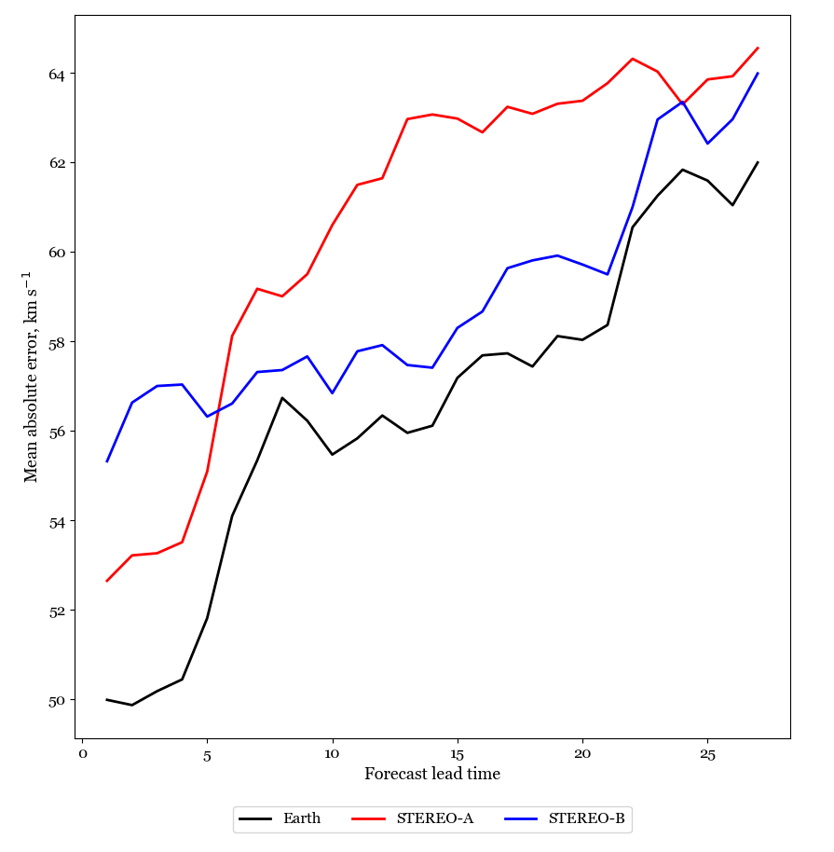
Forecast error against lead time
Error generally increases with lead time
Longer lead time forecasts are worse, which would be expected
H. Turner
h.turner3@pgr.reading.ac.uk
Quo Vadis
Notes:
Possible Q: Why would you expect it to get worse as lead time increases?
Explain plot better

Slide 22
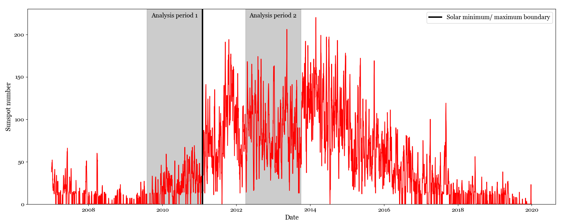
Analysis periods
Two analysis periods – solar minimum and solar maximum
H. Turner
h.turner3@pgr.reading.ac.uk
Quo Vadis
Notes:
What is the graph showing – restructure as the sunspot cycle stuff has been removed
For my work I have used two analysis periods, one in solar minimum and one in solar maximum. These are highlighted in grey on this plot, from August 2009 to February 2012 in solar minimum and April 2012 to October 2013 in solar maximum. Here, the red line shows the sunspot number, which can be used as an indicator of solar activity. Larger sunspot number means a more active sun.

Slide 23
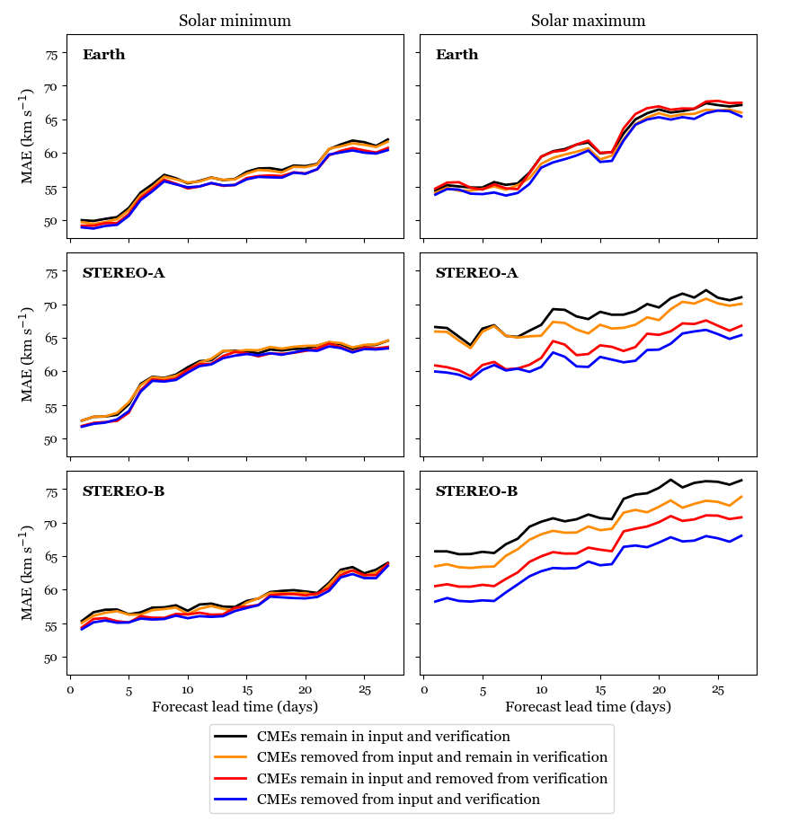
CME removal
H. Turner
h.turner3@pgr.reading.ac.uk
Quo Vadis
Notes:
Possible Q: Is MAE the best metric? How do you compute corotation time from longitudinal separation?

